Slide 1

The Course of Atmospheric Thermodynamics
MUSTANSIRIYAH UNIVERSITY
COLLEGE OF SCIENCES
ATMOSPHERIC SCIENCES DEPARTMENT
2020-2021
Dr. Sama Khalid Mohammed
SECOND STAGE
Lecture 1

Slide 2
Welcome Students
In The New Course
& In The First Lecture ☺

Slide 3
This lecture including the following items
Geopotential and Geopotential Height
Thickness and the hypsometric equation
Exersice

Slide 4

GEOPOTENTIAL Φ(z)
Since Earth is rotating, the force observed as Gravity is the resultant of the:
Gravitational acceleration + Centrifugal acceleration from the Earth’s rotation.
The acceleration due to gravity is not constant, it varies from place to place, with the largest variation due to latitude.
Though small, the variation in gravity must be accounted via the concept of geopotential.

Slide 5
GEOPOTENTIAL Φ(z)
Definition: the potential energy of a unit mass relative to sea level, numerically Work that must be done against the Earth’s gravitational field in order to raise a mass of 1 kg from sea level to that point.
Units: ‘Work’ is defined as force * distance. It has units of Joules (J). So the work to lift a mass a certain height is: J kg⁻¹. Since a Joule is also defined as a Newton * meter, where Newton = kg m s⁻², we can substitute for J above to yield an alternative unit for geopotential: m² s⁻²
The symbol for geopotential is Φ. Geopotential is defined as having a magnitude of 0 at the Earth’s surface. The Φ at any height above the Earth’s surface is equivalent to the distance traveled multiplied by the gravity at each integration of height:
…….(1)
Notes:
http://glossary.ametsoc.org/wiki/Main_Page

Slide 6

GEOPOTENTIAL Φ(z)
or
where z = height above the surface, and g is the gravity at each height, and be calculated via the following equation
A surface of constant geopotential represents a surface along which all objects of the same mass have the same potential energy.
If gravity were constant, a geopotential surface would lie at a constant altitude, but it is not constant throughout the atmosphere – it decreases as the distance from the center of the earth increases. So a geopotential surface will have varying altitude.
Notes:
http://glossary.ametsoc.org/wiki/Main_Page

Slide 7
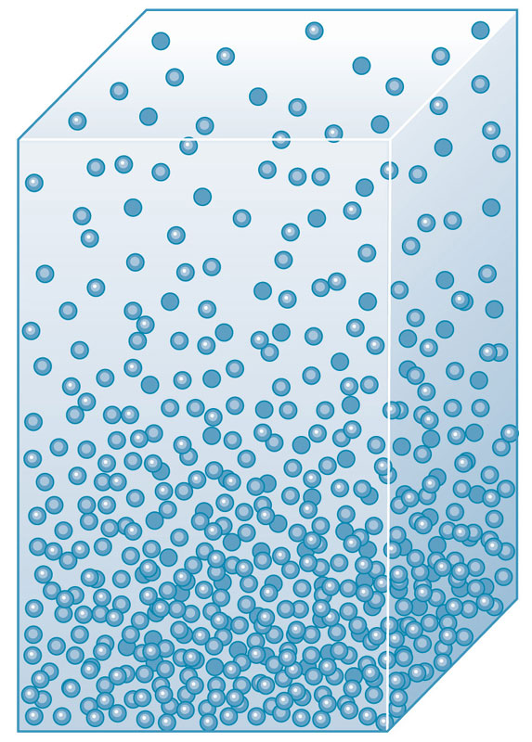
Geopotential Height Z
The geopotential height is defined as the geopotential at height Z (Equation 1) divided by the gravitational acceleration at the surface of the Earth (g_{o}). It is represented as a capital ‘Z’.
Z
……(2)
Where g_{o} is the globally averaged acceleration due to gravity at the Earth’s surface called standard gravity (~ 9.81m/s²), g is acceleration of gravity.
dz

Slide 8
Geopotential Height Z
Geopotential height is used as the vertical coordinate in most atmospheric applications in which energy plays an important role (e.g., in large-scale atmospheric motions). It is expressed in geopotential meters, abbreviated as gpm.
Note that as geometric altitude (z) increases, Z becomes increasingly less because the gravitational acceleration is decreasing. This means less work is required (Φ(z) is getting smaller) to lift the mass to that point because the opposing force (g) is decreasing.
……(2)

Slide 9
Geopotential Height Z
In the lower atmosphere, Z is very close to z (called the ‘geometric or actual height’) where g_{o} ~ g, The table below shows how Z,z, and g vary with height at a typical mid-latitude location.
z(km) | Z(km) | g(ms⁻²)
0 | 0 | 9.802
1 | 1 | 9.798
10 | 9.986 | 9.771
20 | 19.941 | 9.741
30 | 29.864 | 9.71
60 | 59.449 | 9.62
90 | 88.758 | 9.531
120 | 117.795 | 9.443
160 | 156.096 | 9.327
200 | 193.928 | 9.214
300 | 286.52 | 8.94
400 | 376.37 | 8.677
500 | 463.597 | 8.427
600 | 548.314 | 8.186

Slide 10

Geopotential Height Z
If the change in gravity with height is ignored, geopotential height and geometric height are related via
If the local gravity is stronger than standard gravity, then Z > z.
If the local gravity is weaker than standard gravity, then Z < z.
Gravity varies, at the North Pole is approximately 9.83 m/s², while at the Equator it is about 9.78 m/s².
Therefore, g/g₀ ~ 1, and for many applications we can ignore the difference between geopotential and geometric height, since Z ~ z.
But, keep in mind that they are different, and at times this difference, though small, is very important and cannot be neglected.
Notes:
The magnitude of the force of gravity at sea level decreases from the poles, where the centrifugal force is zero, to the equator, where the centrifugal force is a maximum but directed opposite to the force of gravitation.
Gravity is often assumed to be the same everywhere on Earth, but it varies because the planet is not perfectly spherical or uniformly dense. In addition, gravity is weaker at the equator due to centrifugal forces produced by the planet’s rotation. It’s also weaker at higher altitudes, further from Earth’s centre, such as at the summit of Mount Everest.

Slide 11
Geopotential Height Z
So why care about Z and Φ?
It can be used to derive the hypsometric equation.
Effective gravity (g) is perpendicular to lines of constant geopotential surfaces, not geometric height
It is frequently used to convert surface pressures to mean sea level pressures, through manipulation of the hypsometric equation.

Slide 12

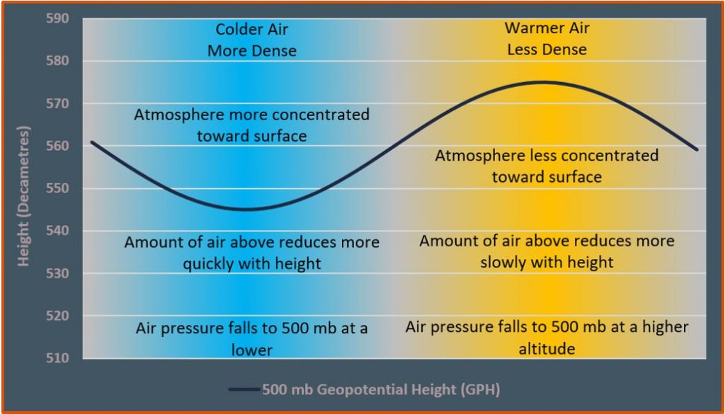
Thickness and the hypsometric equation
The hypsometric equation tells us that the thickness between two pressure levels is directly proportional to the average temperature within the layer.
We can use thickness as a measure of the average temperature of a layer.
We can use contours of thickness in a similar manner to how we use isotherms.
Colder layers are thinner, warmer layers are thicker.

Slide 13

Why using hypsometric equation
Weather observing stations measure station pressure, which must be converted to sea-level pressure for reporting and plotting on weather charts.
The method of calculating the sea-level pressure is called pressure reduction or reducing the pressure to sea-level
Sea-level pressure reduction is accomplished via the hypsometric equation, treating Z₁ = 0 as sea level, and Z₂ = Z_{sta} as the geopotential height of the station.
This means p1 = p_{sl}, the sea-level pressure, P₂ = P_{sta}, the station pressure, and by Rearranging hypsometric equation with these definitions give:
There are different formulas used in various applications according to the layer-average temperature in the hypothetical atmospheric layer between the surface and sea level.

Slide 14
Exercise
If the thickness of the 1000 – 500 hPa layer is 5400 gpm, what is the layer average temperature in kelvin?
What is the geopotential and why it is used?
How to reduce the pressure at the station to the pressure at MSL? Write down a formula.

